Slide 1
Advanced REDCapR Functions
REDCap + R Workshop
REDCapCon 2023

Slide 2
Your Turn #1
Use green Tw Cen MT 44 for text
Use blue Monaco 36 for code
Be explicit about mode of feedback (e.g.: Click “yes” when you are finished.)

Slide 3
[Section]

Slide 4
https://htmlpreview.github.io/ ?https://github.com/skadauke/redcapcon_2023_redcap_r_workshop/blob/main/exercises/03_advanced.html https://github.com/skadauke/redcapcon_2023_redcap_r_workshop

Slide 5



Recap
Write 1-2 sentences to recap each major point of the session
Have a visual representing the section to the left
Notes:
To recap what we covered up to this point, …

Slide 6
What else?
Notes:
The “What Else?” section should mention things that would be covered in a comprehensive course and/or are of strong interest to the intended audience

Slide 7
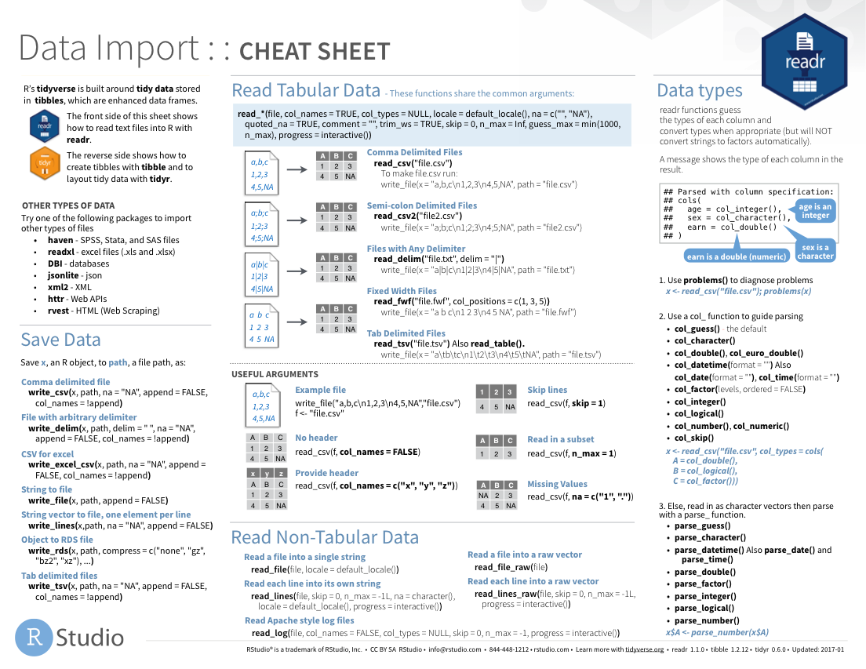
Notes:
Cheat sheets would go here

Slide 8
Notes:
As would other packages that do things

